Slide 1
Notes:
We recommend that you have the info for staff and parents handy so any extra questions can be asked.
Each slide has notes if needed.
This is not timed so you can go at your own pace.

Slide 2
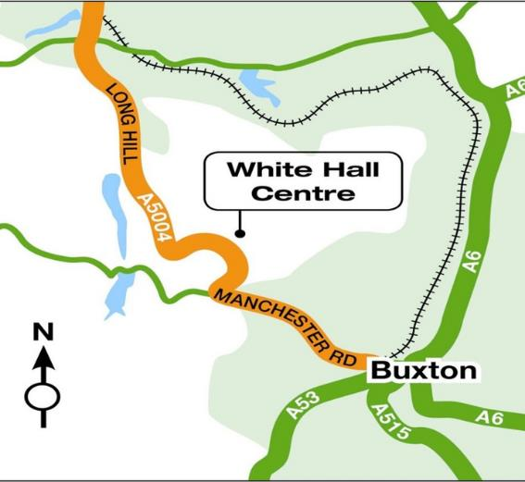
Where are we?
In the heart of the Peak district
Notes:
White hall is in the heart of the Peak District. In the Peak District National Park and 4 miles outside Buxton. At 400 meters White Hall has stunning views of the Goyt Valley and the moors around. Visits to White Hall experience the large grounds (35 acres of woods, ponds and fields) but also the stunning countryside around.

Slide 3
70 years plus of outdoor provision
Personal development and education has been at the heart of White Hall from the beginning.
Notes:
White Hall was the first local authority outdoor education center in the UK. Over those 70 years over a million young people have experienced the White Hall Adventure. It has also trained many instructors, teachers and youth workers in that time.

Slide 4
All centres are Health and Safety compliant.
Safety Management Systems has been externally inspected and verified.
First-Aid Kits are taken on all activity sessions.
Centre Activity Managers hold the Emergency First Aid at Work Accreditation.
Daily safety and equipment checks are carried out
Thorough Risk Assessments have been conducted.
All staff are DBS checked.
Buxton Hospital is 8mins away.
Notes:
White Hall was the first local authority outdoor education center in the UK. Over those 70 years over a million young people have experienced the White Hall Adventure. It has also trained many instructors, teachers and youth workers in that time.

Slide 5
Why come to White Hall?
Notes:
The courses, which White Hall and school plan includes exciting adventure activities using real rock, caves, lakes and hills.
White Hall has robust safety procedures and policies. The safety and welfare of everyone who comes to White Hall is the priority.
White Hall holds a licence from the National Adventure Activity Licencing Authority –this means they are approved to deliver outdoor activities. It indicates and assesses that the centre has been inspected with attention paid to their safety management systems and that they work to nationally accepted standards of good practice.
They also hold the Learning Outside the Classroom Award.
All of the instructors are highly qualified in the activities they deliver and have a wealth and depth of experience of working in outdoor education.
They will do everything they can to ensure the experience will be safe, educational and fun in a caring, welcoming environment.

Slide 6
To encourage working together

Slide 7
Improve communication skills

Slide 8
Gain Independence and self reliance

Slide 9
To overcome challenges
and become more confident

Slide 10
Achieve success and develop a positive attitude

Slide 11
HOW?
THROUGH A SHARED RESIDENTIAL EXPERIENCE
FUN
THROUGH ACTIVITIES

Slide 12
SO WHAT’S YOUR STAY AT WHITE HALL GOING TO BE LIKE?

Slide 13
When you arrive there is time :
to settle into your dorm and make your beds
for a welcome chat
get to know the centre
find your peg and get your equipment
Notes:
White Hall works with the school to reinforce all the school values and rules. We have a few extra to help keep everyone safe:
separate girls and boys dormitary areas, no phones or cameras in dorms or changing areas and bedrooms are private spaces just for those people.
All bedding is provided by the centre. We ask children to make their beds helping to foster a sense on independence.
Every child gets their own peg where they can leave waterproofs and boots that they can borrow from White Hall.

Slide 14
Time to get outside and stuck in!

Slide 15
During your stay you may do some of the following .

Slide 16
Explore the amazing underground world and overcome fears

Slide 17
Gain confidence scrambling, whether on the rocks or in the water.

Slide 18
Achieve success on a rope

Slide 19
And so much more on site

Slide 20
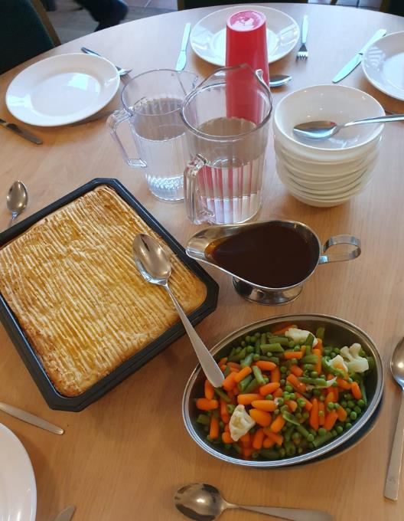
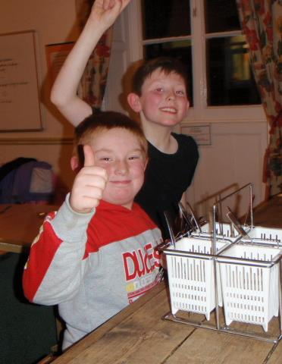
To keep energy levels up, all White Hall meals are delicious, healthy and home cooked.
And there are a few duties to be done after meals.
Notes:
All meals at White Hall are home cooked. We can cater for any dietary need but we do need advance notice. We are a nut free centre. Meals are family style where everyone sits, serves and chats together.
After meals there are a few simple chores/duties to be done.

Slide 21
THE ADVENTURES DON’T STOP AT TEA.
Night Hike
Wide games
Shelter building
Test your map reading and lead your team on a night walk
Pit your wits against your staff and other teams.
Test your building skills against a “hurricane”

Slide 22
And there is always a little free time.
Notes:
Free time – it is a busy few days but there is some time where children have a bit of time to play, rest, socialise with each other - supervised by school staff.

Slide 23
Then it’s time for supper and bed.
Notes:
Hot chocolate and biscuits.
Bed time to be decided by school staff but we have a general rule of quiet time between 11pm and 7.30am.
There is a member of White Hall staff on duty overnight if there is an emergency.

Slide 24
Wednesday | Thursday | Friday
Arrive at school at usual time 8:40 | Get up 7:00am | Get up 7:00am
Film, Games and Preparation morning | Breakfast 8:00am | Breakfast 8:00am
Leave for White Hall at 10:30am | First activity 9:00am – 1:00pm | First activity 9:00am – 12:00pm
Arrive at White Hall 12:00pm |  | Course Summary
Welcome Chat and Lunch | Lunch | Earlier Lunch
Sort out Dorm Rooms and ice breaker games before first main activity | Second Activity till 5:15pm | Depart for Audlem 1:00pm
First activity 3:45-5:15pm |  | Arrive back at Audlem 2:30pm
Evening Meal 5:30pm | Evening meal 5:30pm
Downtime before evening activity | Free time (recharging)
Evening activity 7:30pm | Evening activity 7:30pm
Return to rooms 9.00pm Lights off 10pm | Return to rooms 9:00pm
Lights out 10:00pm | Lights out 10:00pm
Notes:
1. All staff have the appropriate National Governing Body Qualifications and training. All staff including house staff are first aid qualified and have been DBS checked.
2. You may be sharing with another school but if so it will be with children of a similar age. Children will be in dormitories and activity groups with other children from their own school.
3. We monitor the weather constantly and will change activities if needed to keep everyone safe.
4. Whenever possible we like to keep the same instructor with each group, so they can get to know their needs and tailor the activities appropriately.
5. White hall caters for all dietary needs - we just need to know in advance. We are a nut free centre.

Slide 25
Staff Attending
Mr Trude
Mr Perry
Mr Blenkiron
Miss Latham
Mrs Taylor
Mrs Fell
Notes:
6. White Hall is very security conscious - external doors only open from the inside unless there is a key code, we have security cameras and a robust visitor policy.
7. White Hall is owned and run by Derbyshire CC. As part of Derbyshire County Council White Hall has public liability insurance.
Schools and individuals are advised to take out insurance against personal injury, cancellation, loss or damage and ill health.
White Hall holds a licence from the National Adventure Activity Licencing Authority –this means they are approved to deliver outdoor activities. It indicates and assesses that the centre has been inspected with attention paid to their safety management systems and that they work to nationally accepted standards of good practice.
We also hold the Learning Outside the Classroom Award.
8.
1. via the school
2. via the centre office -
01298 23260
3. at night via the duty phone - 07900 617222
9. White hall provides all bedding.
10.
What should you pack – A full list will be sent out to school. Please don’t buy waterproofs and boots especially for the trip as WH provide them. We recommend that electronic items, mobile phones and valuable items are left at home as we are unable to look after them. We also advise against packing new clothing for the activities. WH ask that participants not to wear jewellery during activities.
Remember - old clothes, plenty of warm layers, no jeans for activities, some long sleeves/trousers even in the summer.

Slide 26
Wednesday Morning
Once children come to school, suitcases go into the hall.
Suitcases need to be labelled with your child’s name and name of school.
Medicines must be labelled and handed to Mrs Taylor.
If your child gets travel-sick, please administer travel-sickness tablets with departure time in mind. They will be placed near the front of the coach, so please let your child’s teacher know.
Form Cs give teachers consent to administer medication provided if needed, but staff will usually call home before doing so.
Children will require a packed lunch as we will be eating upon arrival at White Hall.
No money will be required on this trip.
Notes:
6. White Hall is very security conscious - external doors only open from the inside unless there is a key code, we have security cameras and a robust visitor policy.
7. White Hall is owned and run by Derbyshire CC. As part of Derbyshire County Council White Hall has public liability insurance.
Schools and individuals are advised to take out insurance against personal injury, cancellation, loss or damage and ill health.
White Hall holds a licence from the National Adventure Activity Licencing Authority –this means they are approved to deliver outdoor activities. It indicates and assesses that the centre has been inspected with attention paid to their safety management systems and that they work to nationally accepted standards of good practice.
We also hold the Learning Outside the Classroom Award.
8.
1. via the school
2. via the centre office -
01298 23260
3. at night via the duty phone - 07900 617222
9. White hall provides all bedding.
10.
What should you pack – A full list will be sent out to school. Please don’t buy waterproofs and boots especially for the trip as WH provide them. We recommend that electronic items, mobile phones and valuable items are left at home as we are unable to look after them. We also advise against packing new clothing for the activities. WH ask that participants not to wear jewellery during activities.
Remember - old clothes, plenty of warm layers, no jeans for activities, some long sleeves/trousers even in the summer.

Slide 27
Contraband!
Mobile phones or cameras (including disposable) Computer games
Smart watches that are able to connect to the internet.
Jewellery either expensive or of a sentimental value
IPods or other mp3 players
Other items of value or sentimental value.
Sharp or dangerous objects.
Hidden snacks in suitcases etc. (this will be inspected by staff for safeguarding reasons)
Notes:
6. White Hall is very security conscious - external doors only open from the inside unless there is a key code, we have security cameras and a robust visitor policy.
7. White Hall is owned and run by Derbyshire CC. As part of Derbyshire County Council White Hall has public liability insurance.
Schools and individuals are advised to take out insurance against personal injury, cancellation, loss or damage and ill health.
White Hall holds a licence from the National Adventure Activity Licencing Authority –this means they are approved to deliver outdoor activities. It indicates and assesses that the centre has been inspected with attention paid to their safety management systems and that they work to nationally accepted standards of good practice.
We also hold the Learning Outside the Classroom Award.
8.
1. via the school
2. via the centre office -
01298 23260
3. at night via the duty phone - 07900 617222
9. White hall provides all bedding.
10.
What should you pack – A full list will be sent out to school. Please don’t buy waterproofs and boots especially for the trip as WH provide them. We recommend that electronic items, mobile phones and valuable items are left at home as we are unable to look after them. We also advise against packing new clothing for the activities. WH ask that participants not to wear jewellery during activities.
Remember - old clothes, plenty of warm layers, no jeans for activities, some long sleeves/trousers even in the summer.

Slide 28
Downtime (when not in games rooms)
Reasonably sized teddies are allowed.
But consider how you would feel if they were damaged or lost…
Book/magazines can be brought to read in free time
A small toy or puzzle
Small card games
Notes:
6. White Hall is very security conscious - external doors only open from the inside unless there is a key code, we have security cameras and a robust visitor policy.
7. White Hall is owned and run by Derbyshire CC. As part of Derbyshire County Council White Hall has public liability insurance.
Schools and individuals are advised to take out insurance against personal injury, cancellation, loss or damage and ill health.
White Hall holds a licence from the National Adventure Activity Licencing Authority –this means they are approved to deliver outdoor activities. It indicates and assesses that the centre has been inspected with attention paid to their safety management systems and that they work to nationally accepted standards of good practice.
We also hold the Learning Outside the Classroom Award.
8.
1. via the school
2. via the centre office -
01298 23260
3. at night via the duty phone - 07900 617222
9. White hall provides all bedding.
10.
What should you pack – A full list will be sent out to school. Please don’t buy waterproofs and boots especially for the trip as WH provide them. We recommend that electronic items, mobile phones and valuable items are left at home as we are unable to look after them. We also advise against packing new clothing for the activities. WH ask that participants not to wear jewellery during activities.
Remember - old clothes, plenty of warm layers, no jeans for activities, some long sleeves/trousers even in the summer.

Slide 29
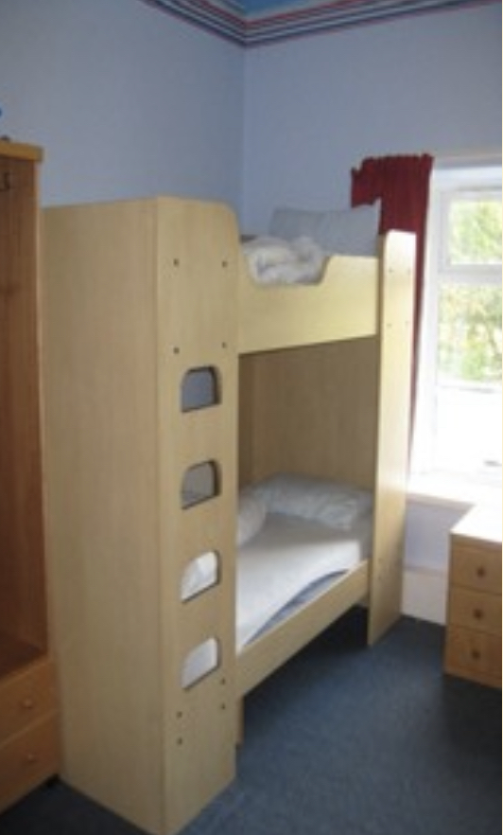
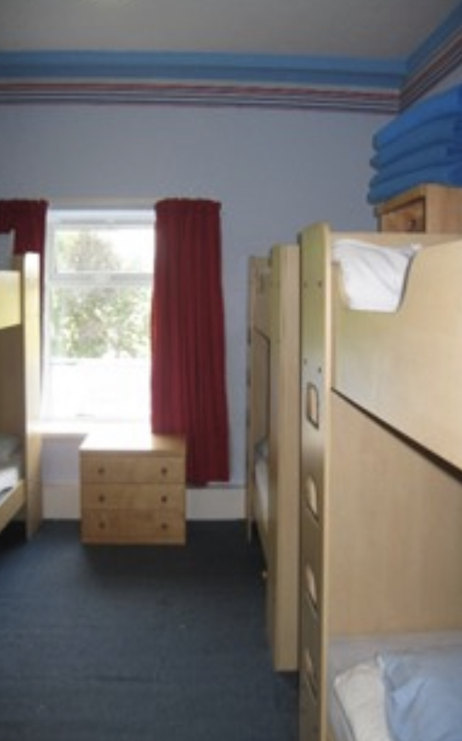
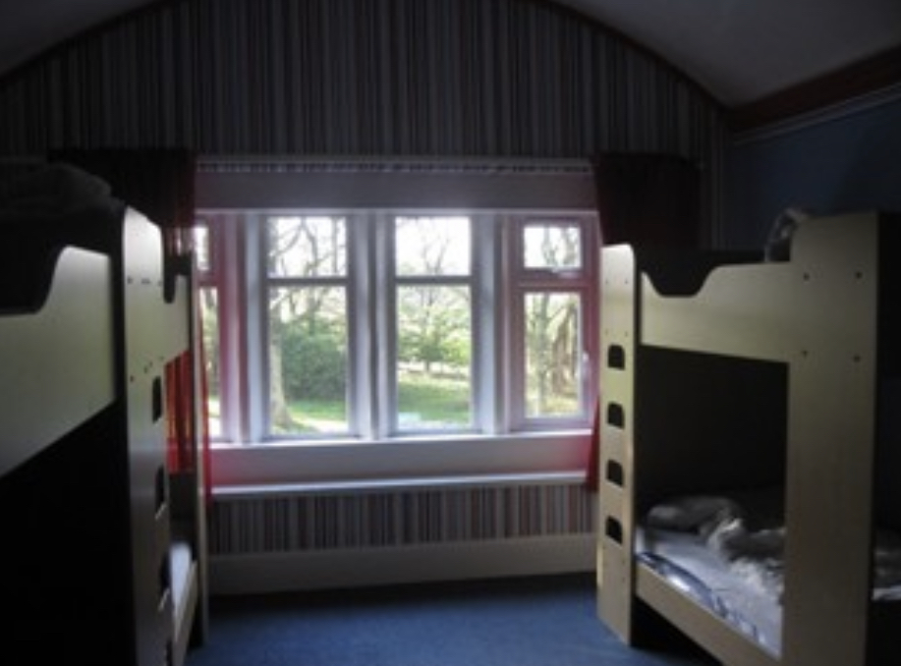
All bedrooms have bunk beds, some have sinks. They were all decorated recently so all the rooms look fresh and welcoming. There are toilets and sinks /showers near the bedrooms and shower rooms downstairs for use after certain activities. The smallest dormitory sleeps 4 and the largest sleeps 12.
Notes:
6. White Hall is very security conscious - external doors only open from the inside unless there is a key code, we have security cameras and a robust visitor policy.
7. White Hall is owned and run by Derbyshire CC. As part of Derbyshire County Council White Hall has public liability insurance.
Schools and individuals are advised to take out insurance against personal injury, cancellation, loss or damage and ill health.
White Hall holds a licence from the National Adventure Activity Licencing Authority –this means they are approved to deliver outdoor activities. It indicates and assesses that the centre has been inspected with attention paid to their safety management systems and that they work to nationally accepted standards of good practice.
We also hold the Learning Outside the Classroom Award.
8.
1. via the school
2. via the centre office -
01298 23260
3. at night via the duty phone - 07900 617222
9. White hall provides all bedding.
10.
What should you pack – A full list will be sent out to school. Please don’t buy waterproofs and boots especially for the trip as WH provide them. We recommend that electronic items, mobile phones and valuable items are left at home as we are unable to look after them. We also advise against packing new clothing for the activities. WH ask that participants not to wear jewellery during activities.
Remember - old clothes, plenty of warm layers, no jeans for activities, some long sleeves/trousers even in the summer.

Slide 30
Teacher rooms are situated within the same building as the children.
We have exclusive use of our building.
Senior Staff Members are on duty until 10:30pm each day with Staff available between the hours of 10:30pm and 07:30am. (The centre has CCTV monitoring the grounds at all times).
Centre doors are secured in the evening, but can be opened in case of emergency and security barriers guard the entrance to the site.
All bedding is provided, but children need to bring their own towels.
All rooms are accessed via keys and are lockable from the inside.
Notes:
6. White Hall is very security conscious - external doors only open from the inside unless there is a key code, we have security cameras and a robust visitor policy.
7. White Hall is owned and run by Derbyshire CC. As part of Derbyshire County Council White Hall has public liability insurance.
Schools and individuals are advised to take out insurance against personal injury, cancellation, loss or damage and ill health.
White Hall holds a licence from the National Adventure Activity Licencing Authority –this means they are approved to deliver outdoor activities. It indicates and assesses that the centre has been inspected with attention paid to their safety management systems and that they work to nationally accepted standards of good practice.
We also hold the Learning Outside the Classroom Award.
8.
1. via the school
2. via the centre office -
01298 23260
3. at night via the duty phone - 07900 617222
9. White hall provides all bedding.
10.
What should you pack – A full list will be sent out to school. Please don’t buy waterproofs and boots especially for the trip as WH provide them. We recommend that electronic items, mobile phones and valuable items are left at home as we are unable to look after them. We also advise against packing new clothing for the activities. WH ask that participants not to wear jewellery during activities.
Remember - old clothes, plenty of warm layers, no jeans for activities, some long sleeves/trousers even in the summer.

Slide 31
Clothes
Night wear (plus spares if needed)
Underwear
Pairs of socks (including plenty of spares)
Trousers (It is important that the students do not wear jeans whilst doing the activities)
T-Shirts
Long sleeved top
Indoor slippers
Jumper/sweatshirt/fleece
Waterproof jacket/anorak
Waterproof trousers or trousers that can get muddy
Towels
Trainers or other substantial footwear, plus extra to get wet/dirty
Overalls, wellies and other activity-specific clothing/equipment will be provided by White Hall
Toiletries
Toothbrush
Toothpaste
Sponge/facecloth
Soap / Shower gel
Hair products i.e. shampoo/conditioner
Hair ties (for long hair)
Water bottle
Roll-on deodorant if necessary (no aerosols permitted)
Small back-pack for packed lunch on the first day and for any small games to play on the coach. No sweets allowed on the coach. Water only on the coach.
No hairdryers or electrical items
Notes:
6. White Hall is very security conscious - external doors only open from the inside unless there is a key code, we have security cameras and a robust visitor policy.
7. White Hall is owned and run by Derbyshire CC. As part of Derbyshire County Council White Hall has public liability insurance.
Schools and individuals are advised to take out insurance against personal injury, cancellation, loss or damage and ill health.
White Hall holds a licence from the National Adventure Activity Licencing Authority –this means they are approved to deliver outdoor activities. It indicates and assesses that the centre has been inspected with attention paid to their safety management systems and that they work to nationally accepted standards of good practice.
We also hold the Learning Outside the Classroom Award.
8.
1. via the school
2. via the centre office -
01298 23260
3. at night via the duty phone - 07900 617222
9. White hall provides all bedding.
10.
What should you pack – A full list will be sent out to school. Please don’t buy waterproofs and boots especially for the trip as WH provide them. We recommend that electronic items, mobile phones and valuable items are left at home as we are unable to look after them. We also advise against packing new clothing for the activities. WH ask that participants not to wear jewellery during activities.
Remember - old clothes, plenty of warm layers, no jeans for activities, some long sleeves/trousers even in the summer.

Slide 32
^{Activities}
^{Year 6}
^{Leap of Faith}
^{Abseiling}
^{Zip Wire}
^{Ropes Course}
^{Night Hike}
^{Haggis Bandits}
^{Caving}
^{Year 5}
^{Climbing Wall}
^{Ropes Course}
^{Zip Wire}
^{Stream Scramble}
^{Rock Scramble}
^{Night Hike}
^{Haggis Bandits}
Notes:
6. White Hall is very security conscious - external doors only open from the inside unless there is a key code, we have security cameras and a robust visitor policy.
7. White Hall is owned and run by Derbyshire CC. As part of Derbyshire County Council White Hall has public liability insurance.
Schools and individuals are advised to take out insurance against personal injury, cancellation, loss or damage and ill health.
White Hall holds a licence from the National Adventure Activity Licencing Authority –this means they are approved to deliver outdoor activities. It indicates and assesses that the centre has been inspected with attention paid to their safety management systems and that they work to nationally accepted standards of good practice.
We also hold the Learning Outside the Classroom Award.
8.
1. via the school
2. via the centre office -
01298 23260
3. at night via the duty phone - 07900 617222
9. White hall provides all bedding.
10.
What should you pack – A full list will be sent out to school. Please don’t buy waterproofs and boots especially for the trip as WH provide them. We recommend that electronic items, mobile phones and valuable items are left at home as we are unable to look after them. We also advise against packing new clothing for the activities. WH ask that participants not to wear jewellery during activities.
Remember - old clothes, plenty of warm layers, no jeans for activities, some long sleeves/trousers even in the summer.

Slide 33
Top tips from White Hall
Name everything
Learn to make your bed
Learn how to tie your shoelaces
Don’t bring anything valuable
Joe Bloggs

Slide 34
Important Information
Final payment due before trip.
Please complete medical form detailing any allergies, dietary requirements and medication which can be administered if necessary.
Updates will be provided each day either by text, school website/Instagram or notice at school entrance.

Slide 35
We can‘t wait !
Any questions?

