Slide 1

May the Lord be with you
….. And also with you

Slide 2

What is our school Vision and Values?

Slide 3

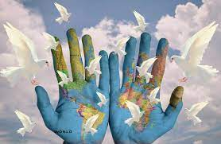
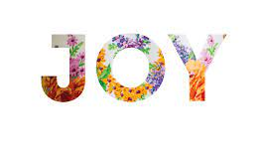
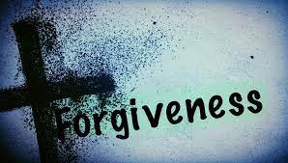
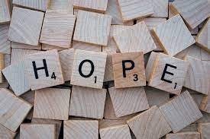
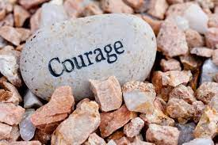
OUR CORE CHRISTIAN VALUES

Slide 4
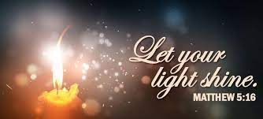

Slide 5
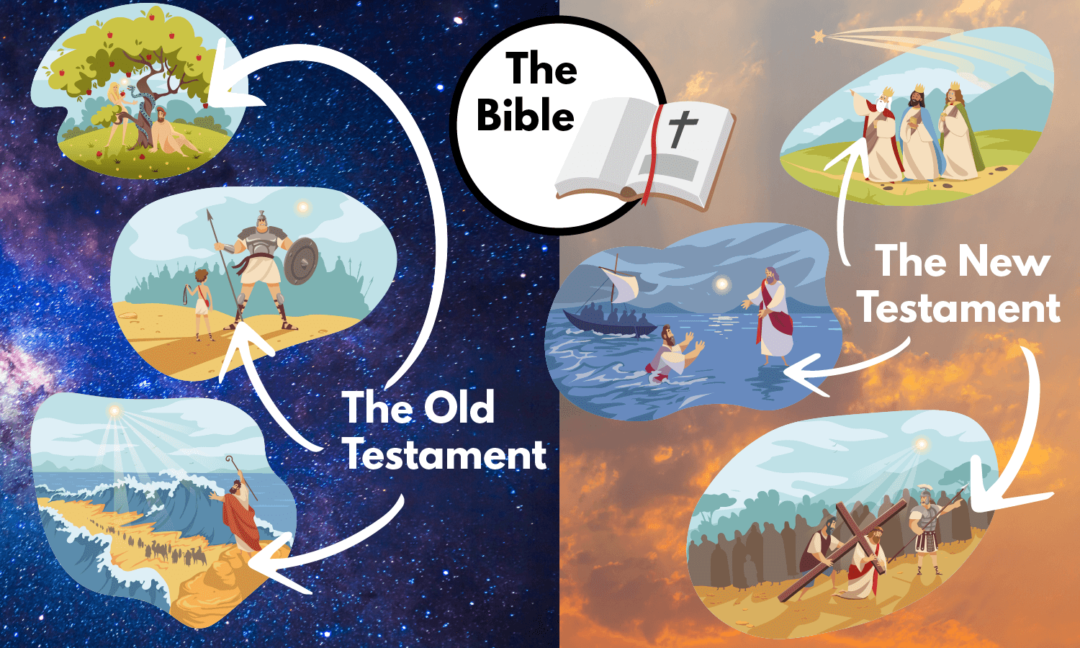

Slide 6
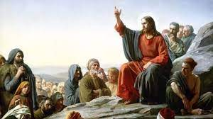
"You are the light of the world. A city built on a hill cannot be hid. 15
No one after lighting a lamp puts it under the bushel basket, but on the lampstand, and it gives light to all in the house. 16
In the same way, let your light shine before others, so that they may see your good works and give glory to your Father in heaven."
Matthew 5:14-16

Slide 7
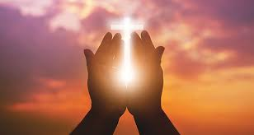
As a Christian school family, we seek to follow the example of Jesus in all that we do. We believe that the Sermon on the Mount is a vital chapter in scripture, teaching us to let the light of Jesus shine through us.

Slide 8
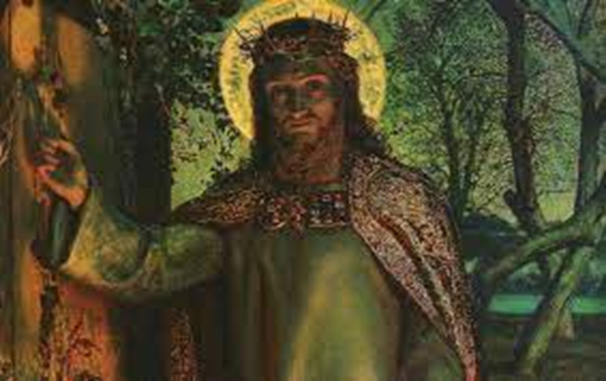
We take great encouragement from the words "you are the light of the world"; this reveals to us that Jesus, who himself tells us "I am the light of the world" (John 8:12), is within all of us.

Slide 9
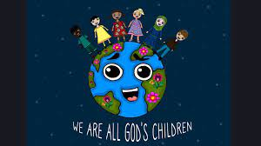
We are all God's children and are called to "give glory" to our Father in heaven through our "good works".
This reminds us of the importance of our actions.
Our actions allow us to let our light shine.
Our actions allow us to share the light of Jesus with those around us.

Slide 10
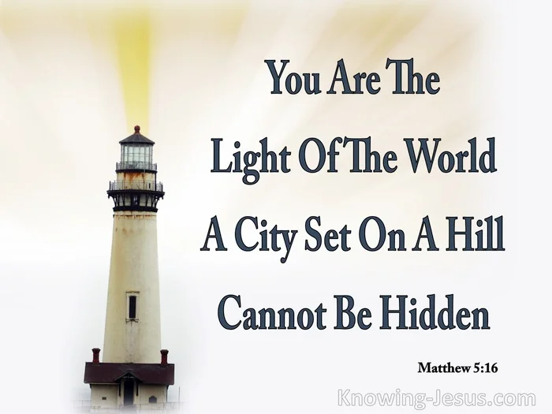
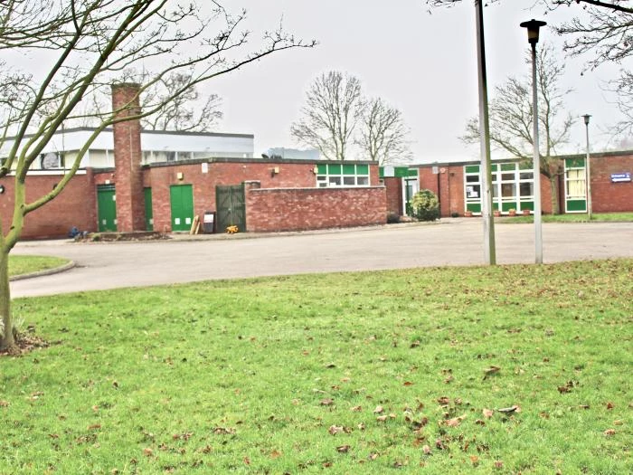
We want our school and church to be beacons that shine far and wide, lighting up our region with the light of Jesus.

Slide 11
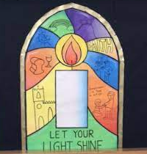
By learning about Christian values, by listening to the teachings of Jesus, and by following the example of Jesus, we say to every member of our community: let your light shine!

Slide 12
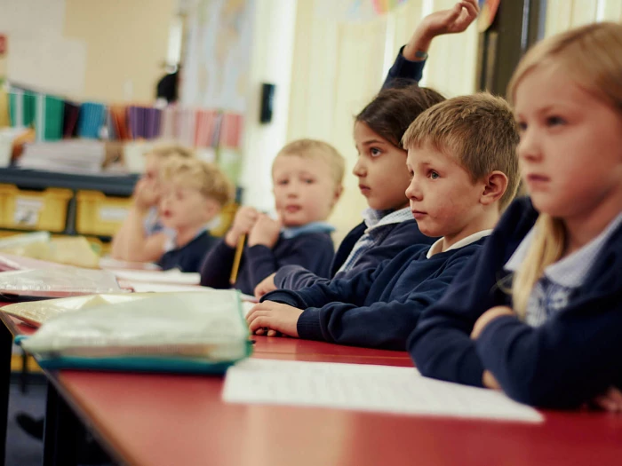
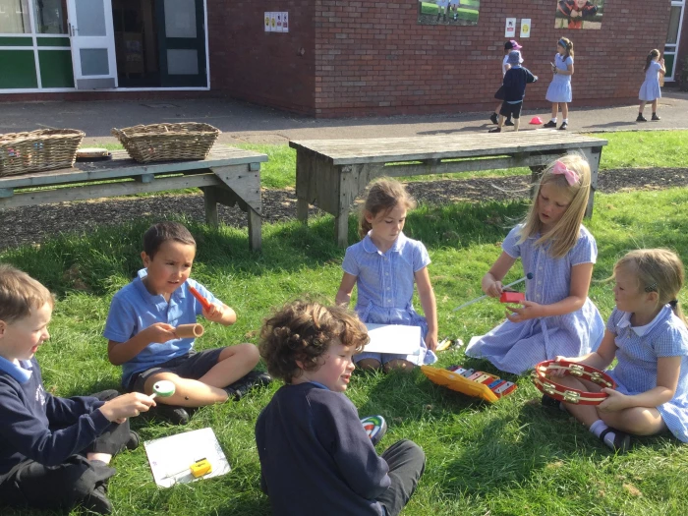
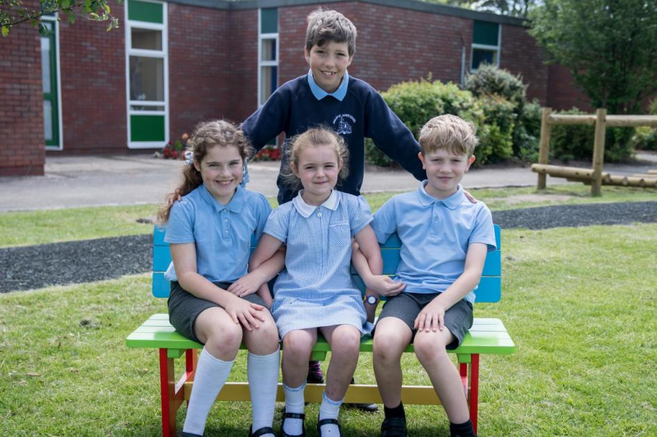
Spirituality in our school
At Audlem St James Primary School we aim to nurture spirituality and provide opportunities for it to grow.
Three elements by which spirituality can be understood:
• Life within us that makes us special and unique
• Divine power woven into values and beliefs of our faith
• A focus on the world we live in – Awe and Wonder
Spiritually has helped us to develop love and respect so that we accept who we are and enjoy good relationships with each other.

Slide 13
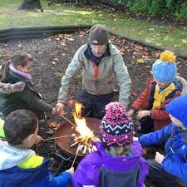
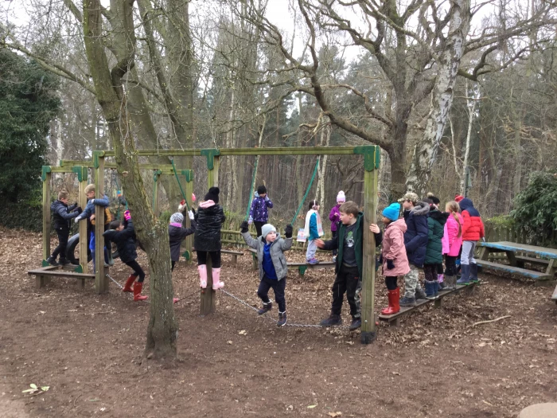
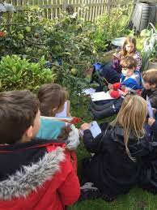
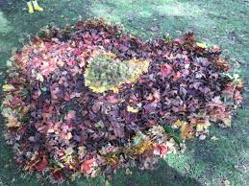
We take an interest and delight in the world around us and are open to what lies beyond the material (this may manifest itself in faith/belief in God).

Slide 14
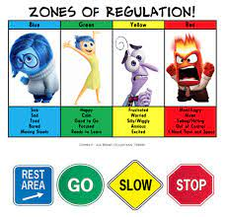


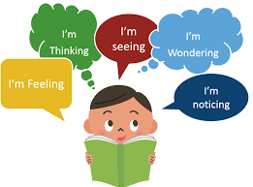
We are able to express and understand feelings, as well as respect those of others. We have a strong moral sense and a love of what is good.
We are able to enjoy quiet and stillness, we possess an active imagination, and show joy in creativity and discovering new skills.

Slide 15
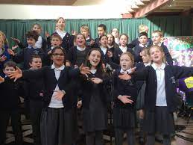



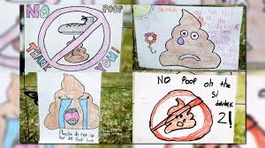
In developing pupils’ spirituality, our curriculum is focused around BIG questions with the key aim of providing pupils with the opportunity to respond to their learning and display what they have learnt.
Where appropriate, teachers plan opportunities for pupils to develop their courageous advocacy where pupils have the opportunity to look beyond themselves and develop an understanding of disadvantage, deprivation and the exploitation of the natural world.

Slide 16

‘Go in peace to love and serve the lord,’ ‘Amen’
……. Amen

