Slide 1

AUDLEM ST JAMES CE PRIMARY SCHOOL
Welcome to
Year 3
A warm welcome to
Amber Class
Meet the Teacher • 2026–2027
Everything families need to know for a happy, confident start to Year 3.
Mrs Parkinson

Slide 2
PEOPLE
02
Meet the Year 3 team
Mrs Parkinson
Mr Parrish
Class Teacher
P.E. session once per week
Mrs Abbott
Mrs Spooner
Recorder session once per week
Teaches one afternoon per week
A team approach
Specialist sessions complement the class timetable throughout the week.
Audlem St James CE Primary School • Year 3 • 2025–2026

Slide 3
GETTING READY
03
Everyday essentials
Named water bottle
Healthy fruit snack
Named bag
Named jumper
Named coat
Home / school diary
Reading books
Please keep diaries and reading books in school bags.
Audlem St James CE Primary School • Year 3 • 2025–2026

Slide 4
DAILY ROUTINES
04
Healthy snacks & water
Water bottles
Snack time
Allergy awareness
Water only — no juice or squash. Cartons of squash can be included in packed lunches.
We strongly encourage a piece of fruit or another healthy snack.
We are a nut- and kiwi-free school. Products labelled “may contain nuts” cannot be brought into school.
Thank you for helping us keep every child safe.
Audlem St James CE Primary School • Year 3 • 2025–2026

Slide 5
OUR DAY
05
A typical morning
8.40
Register
8.50
Spellings & Reading
9.40
English
10.30
Worship
10.45
Break
11.00
Maths
Audlem St James CE Primary School • Year 3 • 2025–2026

Slide 6
OUR DAY
06
A typical afternoon
12.10
Lunch
1.00
Computing • PE • Science• French
2.00
Music • Topic • Art/D&T • RSE •
3.15
Home
Audlem St James CE Primary School • Year 3 • 2025–2026

Slide 7
CURRICULUM
07
Our Year 3 topics
The Stone Age
The Oceans, The Arctic Circle & Antarctica
Ancient Egyptians
Discover how people lived, worked and survived in prehistoric Britain.
Travel back in time to investigate life, beliefs and achievements in Ancient Egypt.
Study of the location of oceans and their impact on humans, plants and animals.
Big themes, memorable learning and plenty of opportunities to make connections.
Audlem St James CE Primary School • Year 3 • 2025–2026

Slide 8
ENRICHMENT
08
Trips that bring topics to life
Stone Age Workshop
Blue Planet Aquarium
Museum of Liverpool
Hands-on learning linked to our Stone Age topic.
A memorable visit supporting rainforest learning.
A curriculum-linked museum experience.
Audlem St James CE Primary School • Year 3 • 2025–2026

Slide 9
SPECIALIST SESSIONS
09
Weekly highlights
Monday
Tuesday
Thursday
Music: Recorders
Recorders can stay in school bags or trays at school.
Swimming
Please ensure your child is able to change and dress themselves independently for swimming.
PE: Netball
Audlem St James CE Primary School • Year 3 • 2025–2026

Slide 10
LEARNING IN YEAR 3
10
Topics & teaching
• We plan carefully for children’s individual needs to ensure progression and support in specific areas.
• Mornings give children focused time to develop English, Maths and spelling skills.
• Guided Reading takes place daily. This may be a whole class session or group work.
• Reading places a strong focus on comprehension as well as word recognition.
Audlem St James CE Primary School • Year 3 • 2025–2026

Slide 11
ENGLISH
11
Handwriting
Daily practice
Building strong foundations
Children will practice handwriting every day.
Handwriting also provides opportunities to recap and consolidate phonics and spelling knowledge.
Audlem St James CE Primary School • Year 3 • 2025–2026

Slide 12
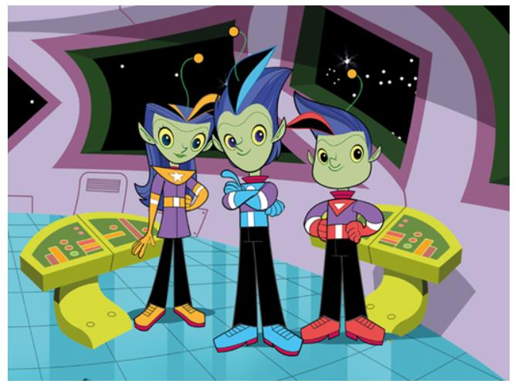
ENGLISH
12
Read Write Inc. Spelling
15 minutes a day
Read Write Inc. Spelling is a 15-minute-a-day programme for Years 2 to 6 (P3–P7).
Its phonics-based, fast-paced approach prepares children for the higher demands of statutory spelling assessments in England.
Audlem St James CE Primary School • Year 3 • 2025–2026

Slide 13
ENGLISH
13
Reading: texts & comprehension
Class texts
Comprehension skills
The Iron Man by Ted Hughes
Ice Palace
by Robert Swindells
• Predict
• Clarify vocabulary
• Read and retrieve
• Read and explain
• Identify themes and conventions
• Discuss language and presentation
• Summarise
• Draw inferences
Audlem St James CE Primary School • Year 3 • 2025–2026

Slide 14
READING
14
Reading books & home–school diaries
• Children can change books most mornings and will be supported with this.
• Please encourage reading at least three times each week, signing and commenting each time. Team points can be earned.
• Reading in class includes: Guided Reading, Whole Class Reading, Individual Reading and Paired Reading.
• Use the diary for messages such as changes to home-time arrangements. Please note that not every diary is checked every day.
Audlem St James CE Primary School • Year 3 • 2025–2026

Slide 15
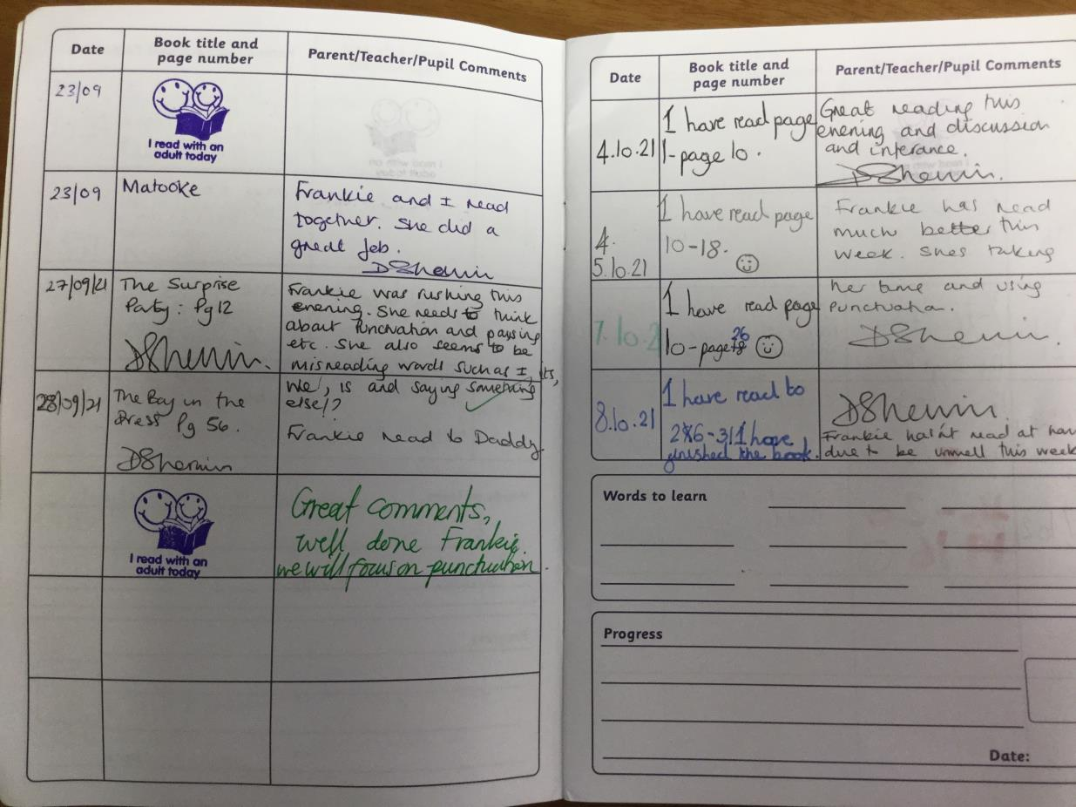
READING
15
Please record your child’s reading
A simple note in the reading diary helps us see what children are enjoying and how often they are reading at home.
You can record it yourself or encourage your child to do so.
Audlem St James CE Primary School • Year 3 • 2025–2026

Slide 16
READING
16
Reading books: continued
• Please read daily with your children, lots of short sessions are much more effective than one weekly session. Asking questions such as summarising what they have read, predicting what they think will happen next, discussing different characters or facts all help children to develop their reading skills.
• Most children have coloured book-band books, please make sure they are in school each day.
• Extra books of their choice are warmly encouraged, alongside their book-band books.
Audlem St James CE Primary School • Year 3 • 2025–2026

Slide 17
ENGLISH
17
Writing — Pathways to Write
Texts that inspire writing
Building confident writers
Stone Age Boy by Satoshi Kitamura
Winter’s Child by Graham Baker-Smith
Children develop punctuation, vocabulary, sentence structure, cohesion and composition through carefully sequenced writing opportunities.
Audlem St James CE Primary School • Year 3 • 2025–2026

Slide 18
MATHS
18
White Rose Maths
Place value
Addition & subtraction
Multiplication & division
Length & perimeter
Fractions
Mass & capacity
Money
Time
Shape
Statistics
A carefully sequenced curriculum across the year.
Audlem St James CE Primary School • Year 3 • 2025–2026

Slide 19
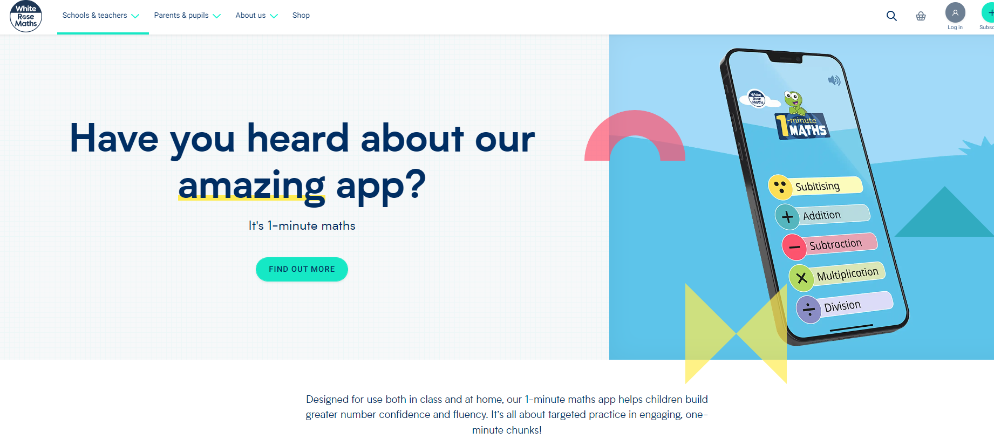
MATHS
19
1-Minute Maths
Short, focused practice
The 1-Minute Maths app supports quick, targeted practice to build number confidence and fluency.
Audlem St James CE Primary School • Year 3 • 2025–2026

Slide 20
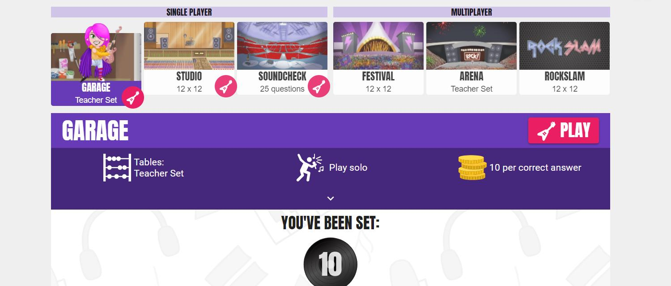
MATHS
20
Times Tables Rock Stars
Teacher-set practice
Children are expected to spend time on TTRockstars as part of their maths practice.
Audlem St James CE Primary School • Year 3 • 2025–2026

Slide 21
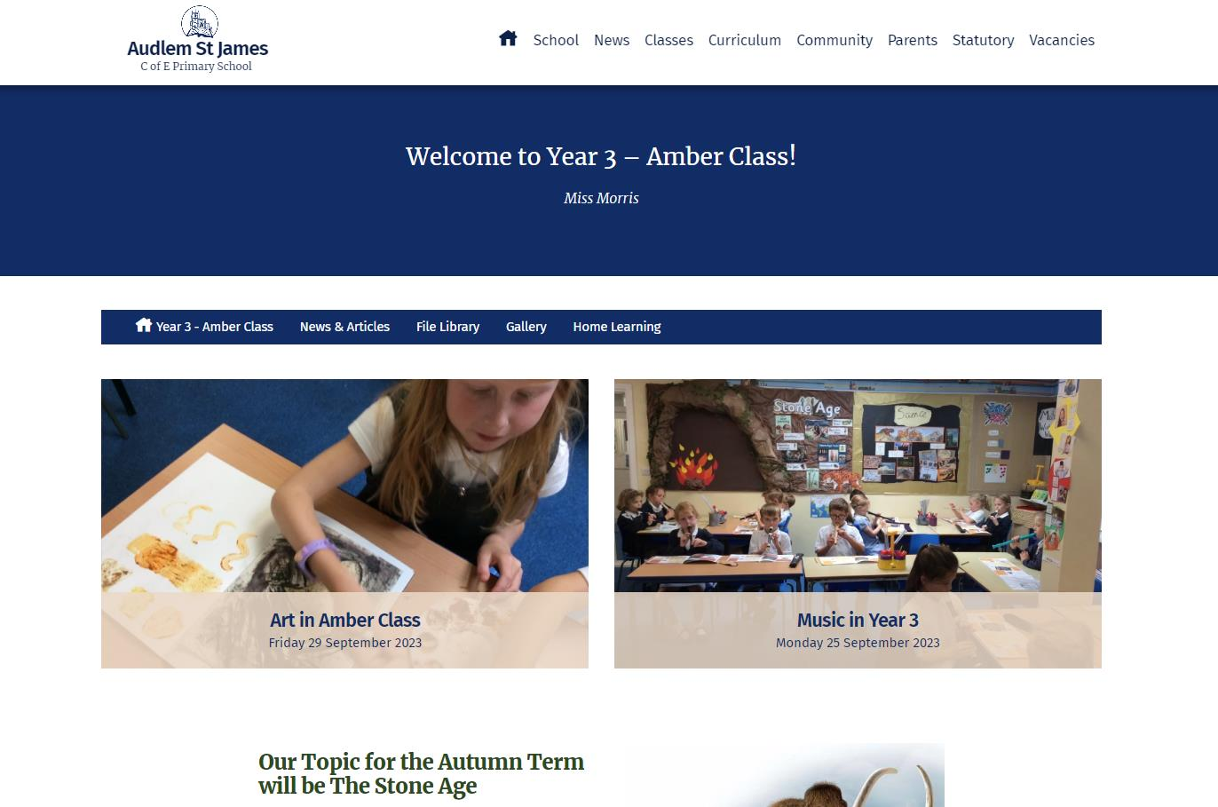
KEEPING IN TOUCH
21
Amber Class on the website
Our class page is a useful place to see news and learning from Year 3.
Class pages are updated with news weekly.
Audlem St James CE Primary School • Year 3 • 2025–2026

Slide 22
OUR SCHOOL CULTURE
22
Relationship Policy
Our vision
Inspired by our Christian values, we are developing our skills, our courage and our wisdom to achieve beyond expectations.
JOY • LOVE • COURAGE • PEACE • FORGIVENESS
Everyone in our learning community should feel valued, included and respected.
RESPONSIBLE • RESILIENT • RESOURCEFUL • READY • REFLECTIVE
Natural & logical
Space to reflect
Focus on repair
Consequences are decided together.
Children can access resources and a calm space.
Put something right, tidy a mess or complete a task.
Audlem St James CE Primary School • Year 3 • 2025–2026

Slide 23
RELATIONSHIPS & REWARDS
23
Celebrating success
• Verbal praise & personal feedback
• House points, certificates & stickers
• Star of the day
• Class pom pom jar
• Team Points
• Praise Book
• Praise postcards
• Class rewards
• Compliments Box
• Lunchtime & Fair Play Superstar Awards
• Attendance awards
• Sports Award
Audlem St James CE Primary School • Year 3 • 2025–2026

Slide 24
FEELING SAFE & READY TO LEARN
24
Wellbeing
• Every class has a ‘Worry Monster’, a calm box and a calm space.
• We teach strategies such as mindfulness and visualisation.
• Children develop emotional vocabulary through Zones of Regulation.
• A footpath encourages extra walking during the day.
• Music helps create a calm learning environment.
• We use the ‘My Happy Mind’ scheme.
Audlem St James CE Primary School • Year 3 • 2025–2026

Slide 25
WELLBEING
25
Emotional Coaching
1
Recognise the child’s feelings and empathise with them.
2
Label the feeling and validate it.
3
Set limits on the behaviour, if needed.
4
Problem-solve with the child.
A calm, relational approach that helps children understand feelings, regulate behaviour and move forward.
Audlem St James CE Primary School • Year 3 • 2025–2026

Slide 26
WELLBEING
26
Zones of Regulation
BLUE
GREEN
YELLOW
RED
• Sick
• Sad
• Tired
• Bored
• Moving slowly
• Happy
• Calm
• Feeling okay
• Focused
• Ready to learn
• Frustrated
• Worried
• Silly/wiggly
• Excited
• Loss of some control
• Mad/angry
• Mean
• Excited
• Yelling/hitting
• Disgusted
• Out of control
Audlem St James CE Primary School • Year 3 • 2025–2026

Slide 27
SCHOOL ETHOS
27
Our Christian values
Hope
Courage
Love
Joy
Peace
Forgiveness
Audlem St James CE Primary School • Year 3 • 2025–2026

Slide 28
WORKING TOGETHER
28
Communication
• To book an appointment, email admin@stjamesaudlem.cheshire.sch.uk.
• Please feel free to speak to Mrs Parkinson at the door.
• Medical or dental appointments must be approved by Mr Perry; teachers cannot approve time away from school.
• Children stay with the teacher unless they have permission to leave unaccompanied.
• If someone different is collecting your child, written permission, email or a phone message is required.
• Class pages on the school website are updated with news weekly.
Audlem St James CE Primary School • Year 3 • 2025–2026

Slide 29
PRACTICAL INFORMATION
29
PE kits
When
What to wear
Cooler weather
Tuesday — swimming.
Thursday — netball
Children come to school in PE kit on Tuesday and Thursday.
Shorts, team-colour T-shirt and trainers.
Please ensure earrings are not worn on PE days or plasters are provided to cover these up.
Tracksuit bottoms and a jumper or lightweight coat may be needed.
Audlem St James CE Primary School • Year 3 • 2025–2026

Slide 30
HOME LEARNING
30
Homework
• Homework is given on Friday and should be returned by the following Thursday at the latest.
• Children log spellings needing extra practice in their reading diaries.
• Children are expected to spend time weekly on TTRockstars.
• There will usually be a piece of English and/or maths homework each week.
• Optional topic homework tasks will be set.
Audlem St James CE Primary School • Year 3 • 2025–2026

Slide 31
HOW YOU CAN HELP
Supporting your child at home
Spelling
Support key-word spelling.
Reading
Develop comprehension, reading for meaning and predicting.
Each term, the class letter shares the topic focus. A weekly ParentMail email is sent on Fridays.
Maths
Practise times tables: 2, 5 and 10.
Stay connected
Thank you for your support — we’re looking forward to a
brilliant year together.

